Slide 1



P.A.D.B.PATHIRAJA
29071
Bsc(Hons) Software Engineerig
22.2

Slide 2

OVERVIEW
The Problem
Existing Solutions
The Research Gap
Technologies to be Used
Dataset & Machine Learning

Slide 3
THE PROBLEM
The Saturation Problem
500 hours of video are uploaded to YouTube every minute, making discovery the biggest hurdle for creators.
The Metadata Bottleneck
A video’s success depends on the "click," a decision made in milliseconds based on the title and thumbnail.
The Skill Gap
High-quality content often fails because creators lack the professional copywriting skills to leverage psychological triggers like "curiosity gaps"
The Cold Start
Without an initial burst of Click-Through Rate (CTR), platform algorithms stop recommending the video, causing it to "die" regardless of its quality

Slide 4
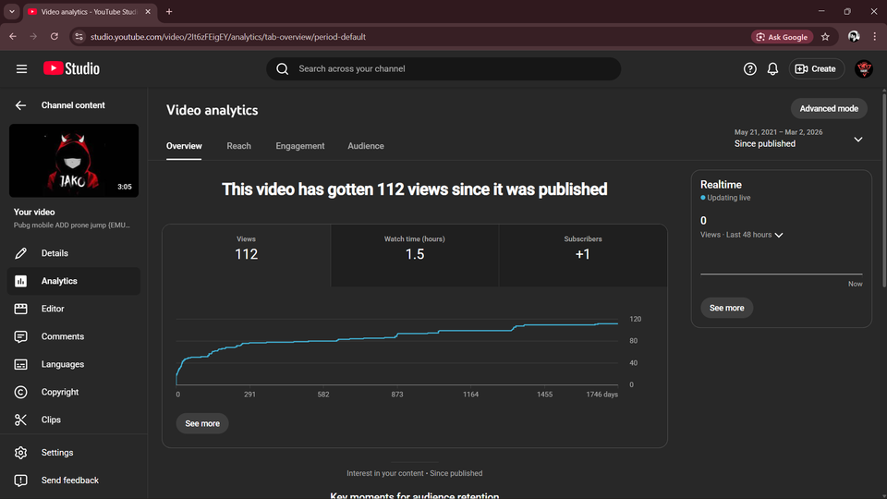
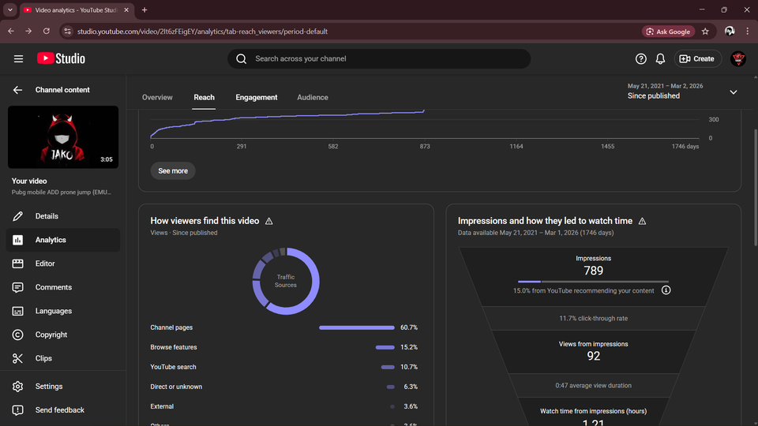
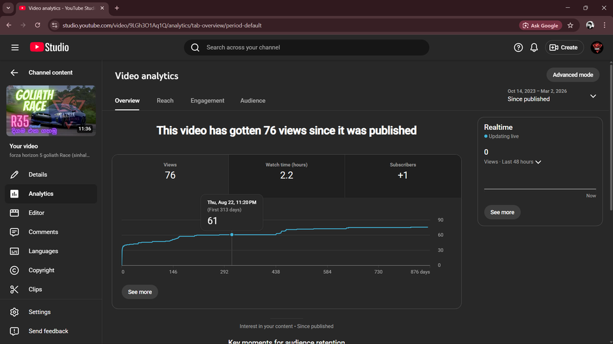
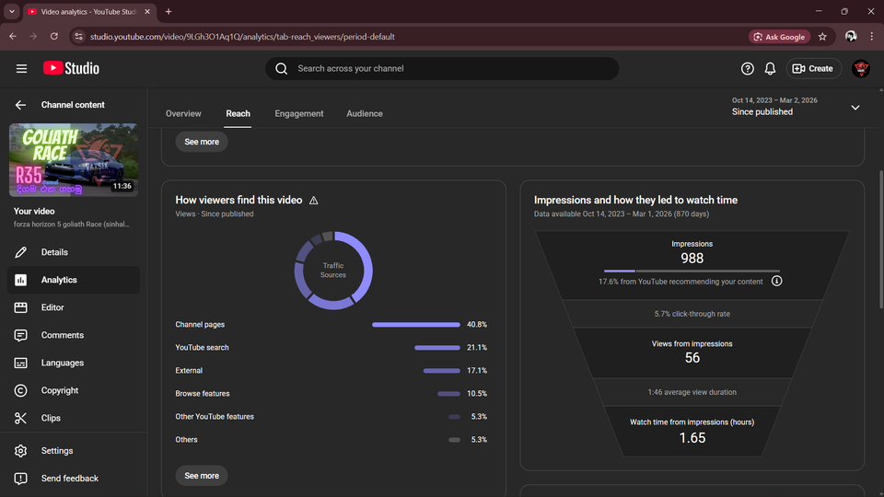
Example 1 (Using Normal Titile)
Example 2 (Using Normal Titile )

Slide 5
EXISTING SOLUTIONS
Manual Copywriting
Experts use heuristic knowledge of psychological triggers (urgency, curiosity) to craft titles, but this is unscalable and inaccessible to most
Generic AI Tools
Standard LLM prompts (e.g., "Write a title") often produce flat, descriptive, or "hallucinated" results that lack viral dynamics.
Analytic Tools
Platforms provide data on what happened (past CTR) but do not proactively generate optimized content to improve future performance.

Slide 6
THE RESEARCH GAP
Proactive vs. Reactive
Existing tools are "reactive" (user-driven); this project proposes a "proactive" system that automatically handles analysis and optimization.
Operationalizing Theory
There is a lack of research on turning psychological theories (like Information Gap Theory) into specific algorithmic prompts.
The Ethics Gap
Most tools focus on either "clicks" (marketing) or "truth" (security); this project bridges the gap by creating "Generative Ethics" that optimize for virality while preventing deception.

Slide 7
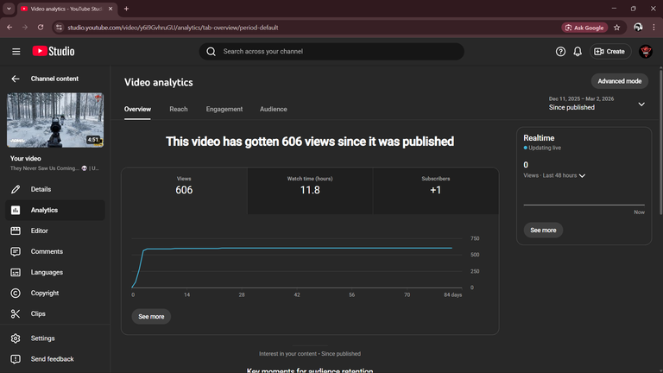
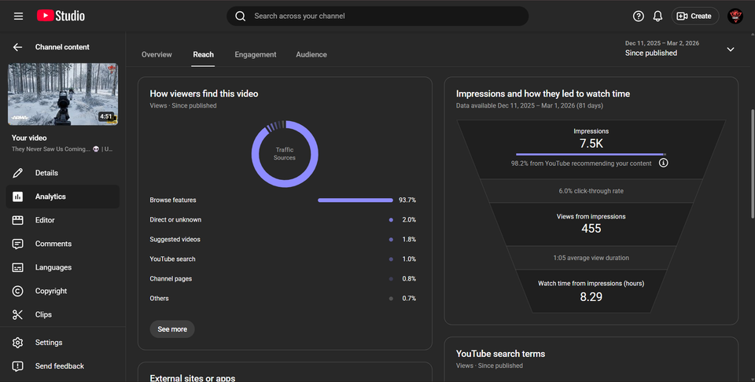
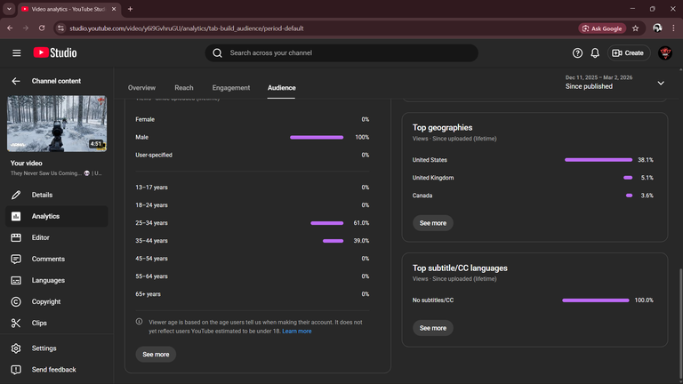
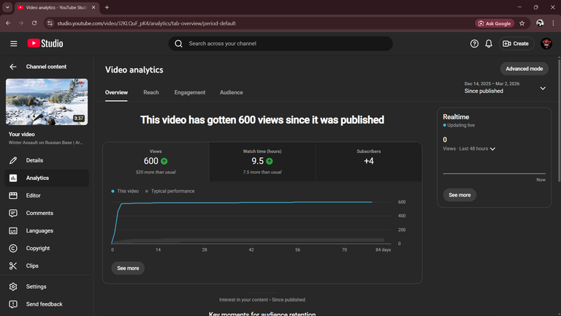
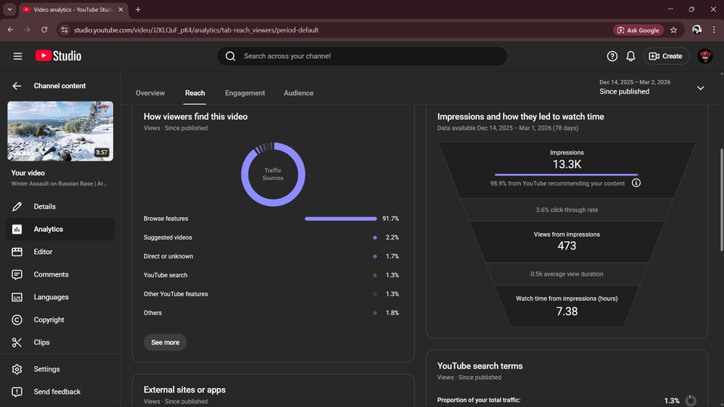
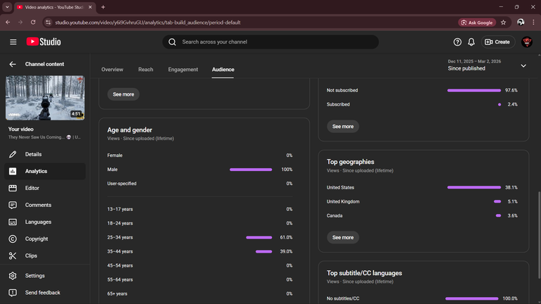
Example 1 (Using AI Genarated Click Bait Titile )
Example 2 (Using AI Genarated Click Bait Titile )

Slide 8
TECHNOLOGIES TO BE USED
Backend
Python (FastAPI) for high-speed asynchronous API management.
Operationalizing Theory
LangChain to manage the interaction between sub-agents (Analyzer, Generator, Critic).
Models
GPT-4o or Llama 3 for generative tasks, and BERTScore for checking semantic faithfulness
Sentiment Analysis
VADER to measure emotional arousal levels in titles.

Slide 9
DATASET & MACHINE LEARNING
Data Sources
Public YouTube Trending Datasets (Kaggle) and targeted scraping via the YouTube Data API.
Dataset Size
Thousands of viral titles from high-performing channels (e.g., MrBeast) to extract linguistic patterns.
ML Task (pCTR Regressor)
V
=
Views
Training a Random Forest or XGBoost model to predict a "Virality Score"
based on title features.
SubsCribers
Validation
Using NLI (Natural Language Inference) to ensure the generated title does not contradict the video summary.

Slide 10
NSBM Green University - March 2026
THANK YOU !
Presented by Dasharatha Bhanu

